Slide 1

Demystifying Code: Intro to Python
by Aaron Johnson
Fall 2019

Slide 2
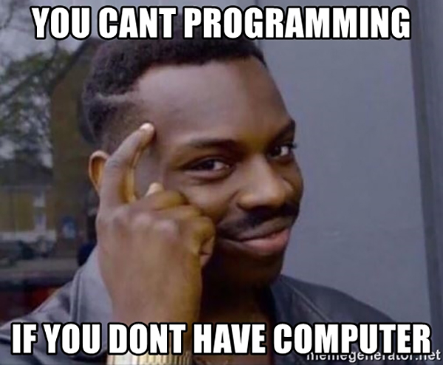
Programming languages
Can be thought of as simply a program that you feed commands to
You can write scripts or programs that make the computer do whatever you can dream up
There are many programming languages at least 700 or so according to Wikipedia

Slide 3
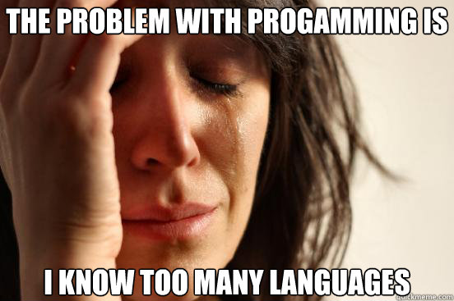
Brief history of programming languages
Aaron's list of most popular languages
1957 - FORTRAN - Compiled
1964 - BASIC - Interpreted
1970 - Pascal - Compiled
1972 - C - Compiled
1980 - C++ - Compiled
1991 - Python - Interpreted
1991 - Visual Basic - Compiled
1995 - Ruby - Interpreted
1995 - Java - Compiled (JVM)
1995 - JavaScript - Interpreted
1995 - PHP - Interpreted
2001 - C# - Compiled (CLR)
2009 - Go - Compiled (Google - produces statically linked native binaries without external dependencies.)
2011 - Dart Compiled/Interpreted (Google - AOT-compiled to JavaScript)

Slide 4
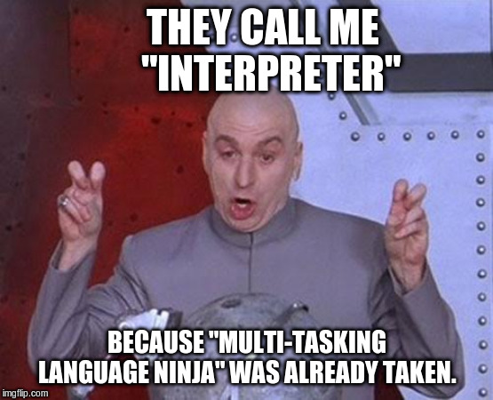
Interpreted vs Compiled
Compiled languages - converted directly into machine code that the processor can execute. As a result, they tend to be faster and more efficient to execute than interpreted languages.
Interpreted languages - the source code is not directly translated by the target machine. Instead, a different program, aka the interpreter, reads and executes the code.

Slide 5
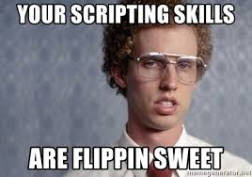
Scripts vs Programs
Scripts are usually interpreted (but not always, such as with golang scripts)
Programs can be either compiled (C++, C#, Java) or interpreted (Python, Ruby, PHP)
The biggest difference is that scripts are written to control an existing program
Scripts often automate manual tasks to make work easier to accomplish
Scripts can accomplish many important tasks and are often written by a single person
Programs usually have very ambitious goals and often take a large amount of time and money to create

Slide 6
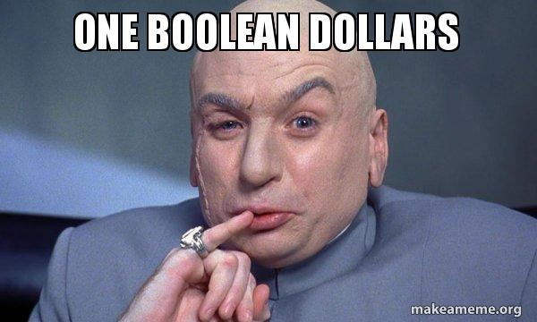
Common Python Data types
Python is a dynamically typed language which means variables themselves are not bound to a specific data type. That said the following are the most commonly used data types in Python
Integers (123)
Strings (abc)
Boolean (True/False)
Lists [1, 2, 3]
Dictionaries {Key: Value}

Slide 7
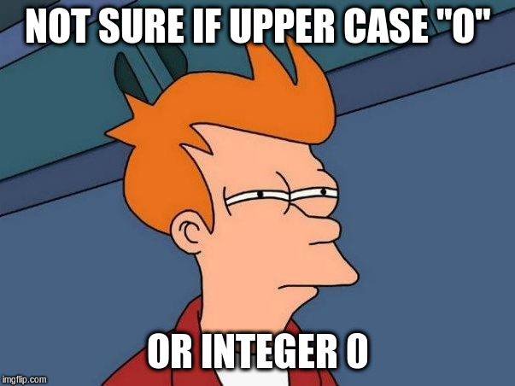
Integers
Integers in python are positive or negative whole numbers with no decimal point
Python 2.7.16 (default, Oct 7 2019, 17:36:04) [GCC 8.3.0] on linux2 Type "help", "copyright", "credits" or "license" for more information. >>> x = 1 >>> y = 2 >>> type(x) <type 'int'> >>> type(y) <type 'int'> >>> print(x + y) 3

Slide 8
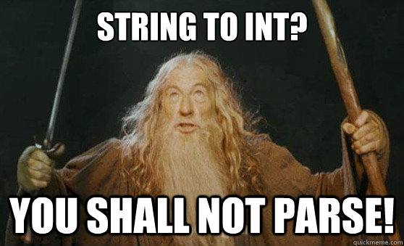
Strings
In python a string is most easily identified by the use of double quotes
Python 2.7.16 (default, Oct 7 2019, 17:36:04) [GCC 8.3.0] on linux2 Type "help", "copyright", "credits" or "license" for more information. >>> x = "This is a string" >>> type(x) <type 'str'> >>> print(x) This is a string

Slide 9
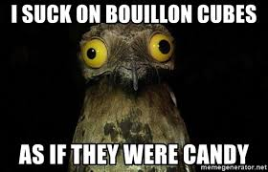
Boolean
Boolean simply means True or False
Python 2.7.16 (default, Oct 7 2019, 17:36:04) [GCC 8.3.0] on linux2 Type "help", "copyright", "credits" or "license" for more information. >>> x = True >>> type(x) <type 'bool'> >>> if x is True: ... print("Boolean is pronounced boo-lee-uhn") ... else: ... print("Boolean is pronounced bool-yaan") ... Boolean is pronounced boo-lee-uhn

Slide 10
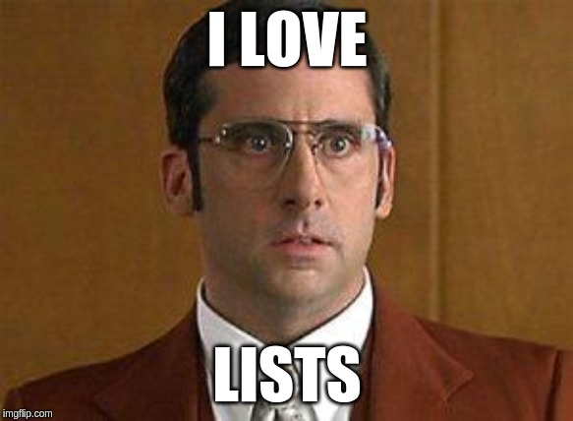
Lists
Lists are denoted by square brackets [ ] and contain comma separated values. Another name for a list is an Array. If the list contains strings then it will need quotes, integers in the list wouldn't have any quotes
Python 2.7.16 (default, Oct 7 2019, 17:36:04) [GCC 8.3.0] on linux2 Type "help", "copyright", "credits" or "license" for more information. >>> x = ["glass", "root beer", "vanilla ice cream", "straw"] >>> type(x) <type 'list'> >>> for index, ingredient in enumerate(x): ... print(index, ingredient) ... (0, 'glass') (1, 'root beer') (2, 'vanilla ice cream') (3, 'straw')

Slide 11
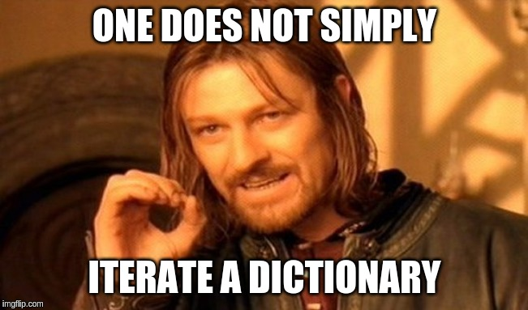
Dictionaries
Dictionaries are denoted by curly braces { } and contain "key": "value" pairs. Another name for a dictionary is a Map. Dictionaries can contain all of the previously mentioned data types including integers, strings, boolean, lists and more.
>>> x = { "christmas": "tree", ... "thanksgiving": "turkey", ... "halloween": "jack-o-lantern", ... "easter": "bunny" ... } >>> type(x) <type 'dict'> >>> for key, value in x.items(): ... print(key, value) ... ('easter', 'bunny') ('halloween', 'jack-o-lantern') ('christmas', 'tree') ('thanksgiving', 'turkey')

Slide 12
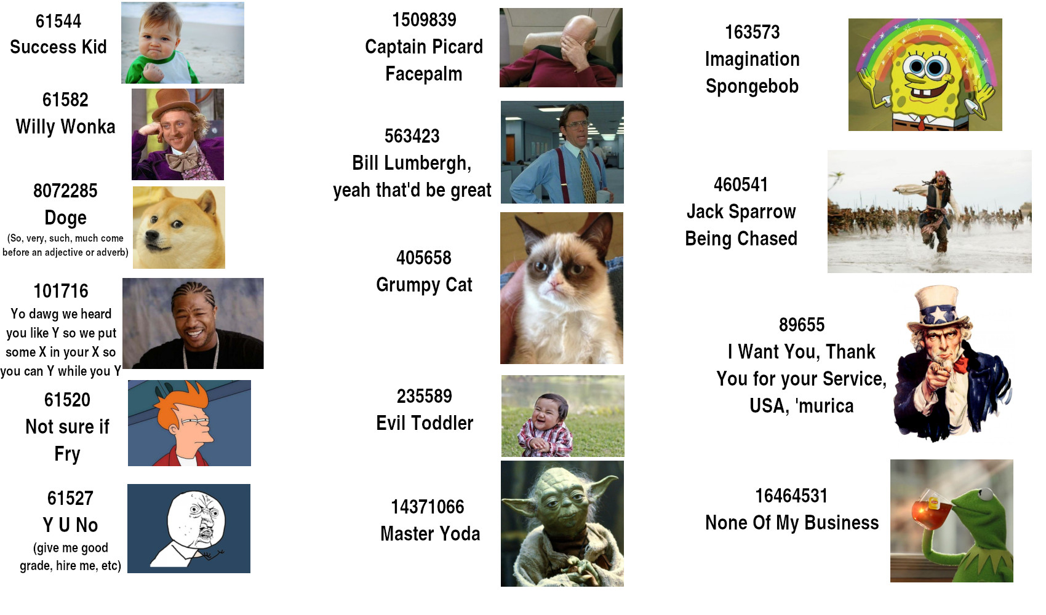
Hands-on Lab!

